Slide 1

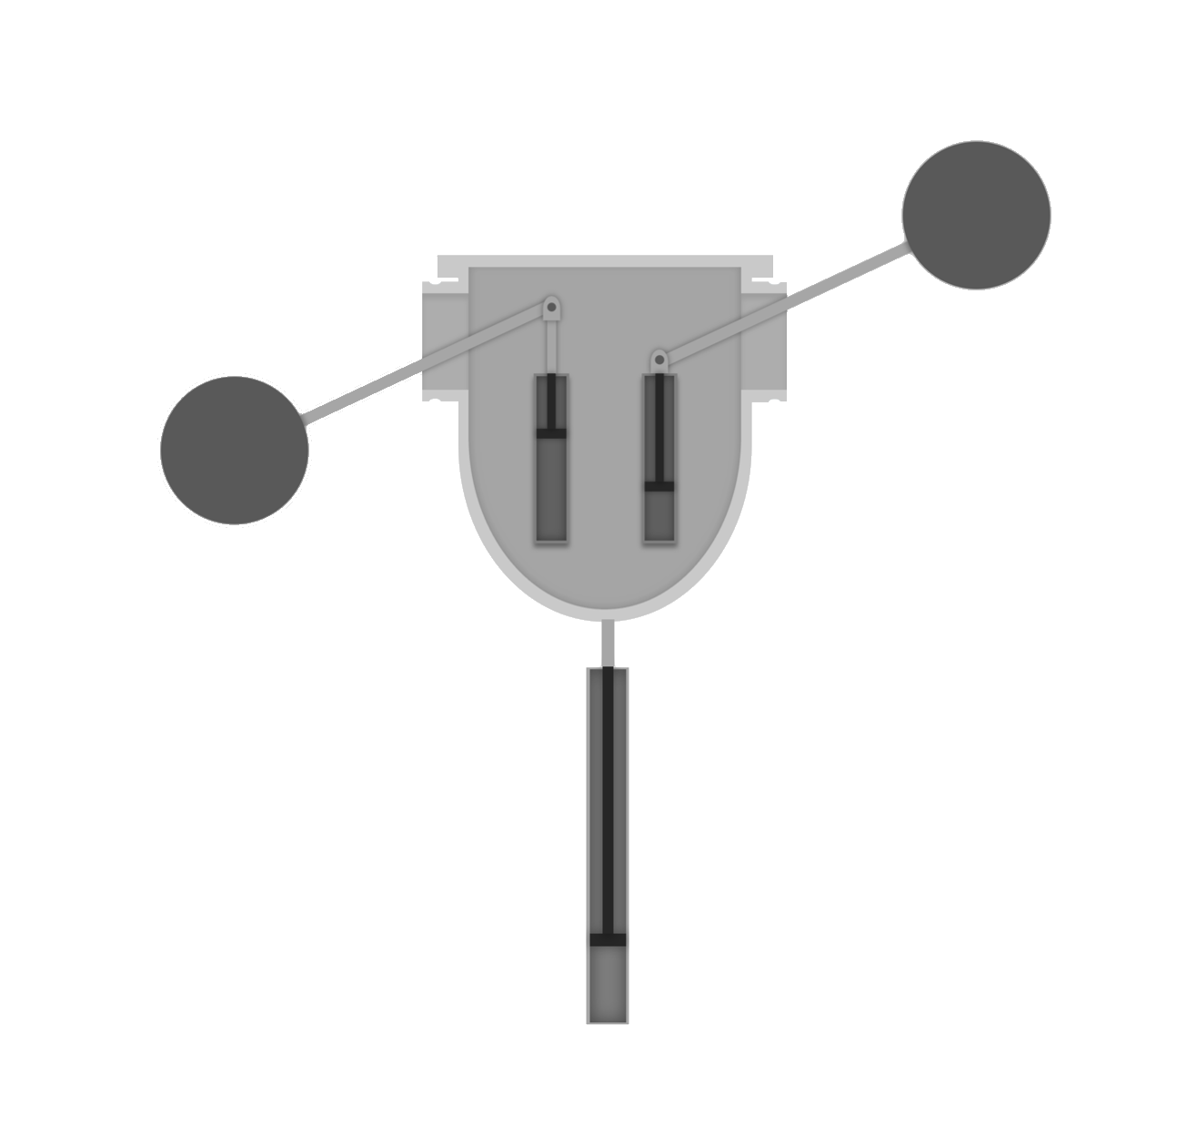






WAVE ENERGY CONVERTER
POINT ABSORBER BUOY
MOVES UP AND DOWN WITH WAVES TO DRIVE PRIMARY PISTON
ATTENUATOR BUOY
PROVIDES BUOYANCY TO ATTENUATOR ARM
ONSHORE GENERATOR
CONVERTS MECHANICAL ENERGY INTO ELECTRICAL
ATTENUATOR ARM
MOVES UP AND DOWN WITH WAVES TO DRIVE SECONDARY PISTON
HYDRAULIC MOTOR
DRIVEN BY PRESSURIZED HYDRAULIC FLUID
SECONDARY PISTON
DRIVEN BY ATTENUATOR ARM MOTION
POWER STORAGE
STORES ENERGY UNTIL IT IS IN DEMAND
PRIMARY PISTON
DRIVEN BY POINT ABSORBER BUOY MOTION
HYDRAULIC LINKAGE
COMPRISES TUBES AND VALVES THAT CONTAIN HYDRAULIC FLUID
This small-scale wave energy converter device produces clean energy at a fraction of the cost and size of similar commercial devices
RELIABLE
LOW MAINTENANCE
COMPACT
INEXPENSIVE

